Slide 1

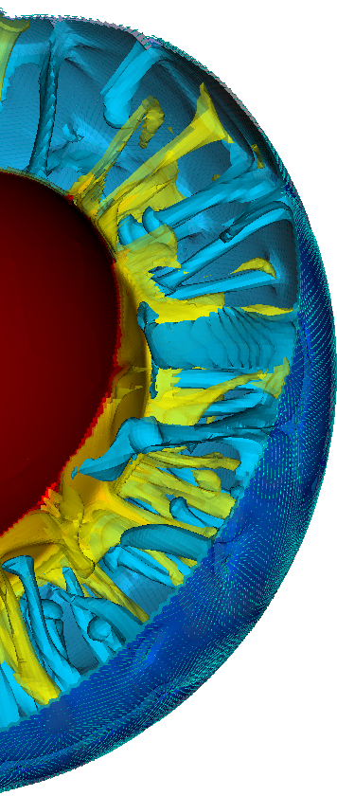
The Computational Infrastructure for Geodynamics is a community-driven organization that advances Earth science by developing and disseminating software for geophysics and related fields.
Louise H. Kellogg, Director Lorraine J. Hwang, Assoc. Director
crust
75+ member institutions
900+ participants worldwide
20 countries
33 Software packages
Used worldwide
mantle
core
CIG is funded by the NSF's Geoinformatics program (in GEO-EAR) with contributions from NSF's Office of Advanced Cyberinfrastructure
Notes:
We aspire to accelerate the understanding of the dynamical properties of the Earth and Earth-like systems from core to crust, and beyond.
We do this by constructing computational models of the earth that are embodied in software.

Slide 2
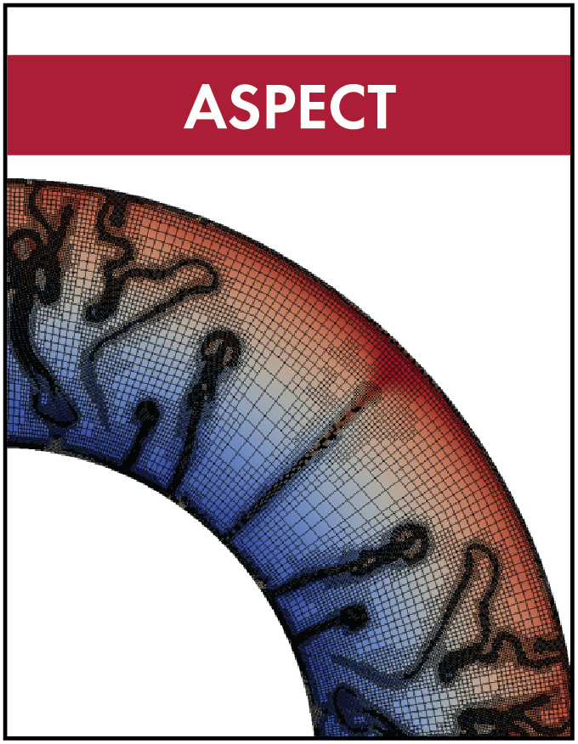
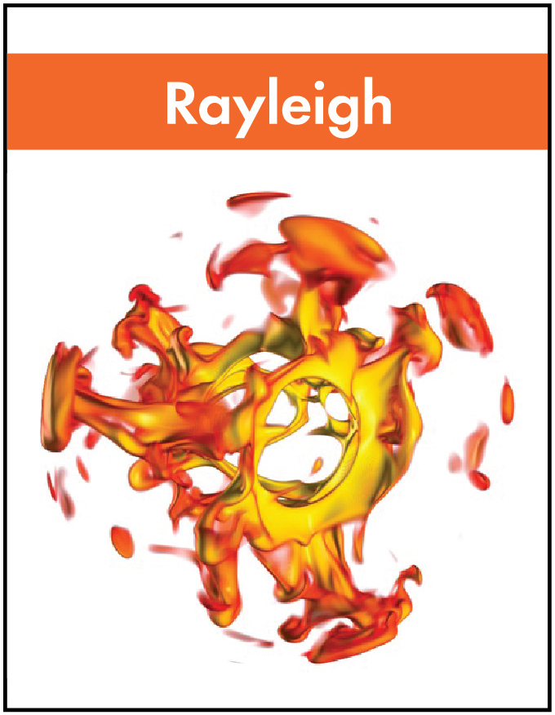
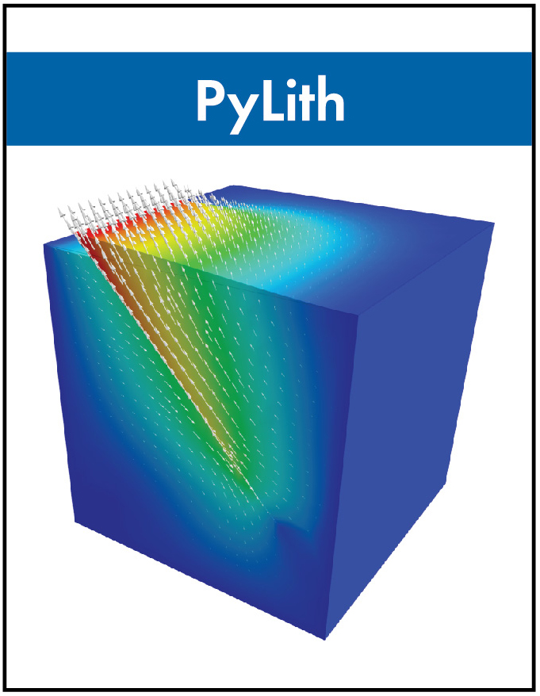
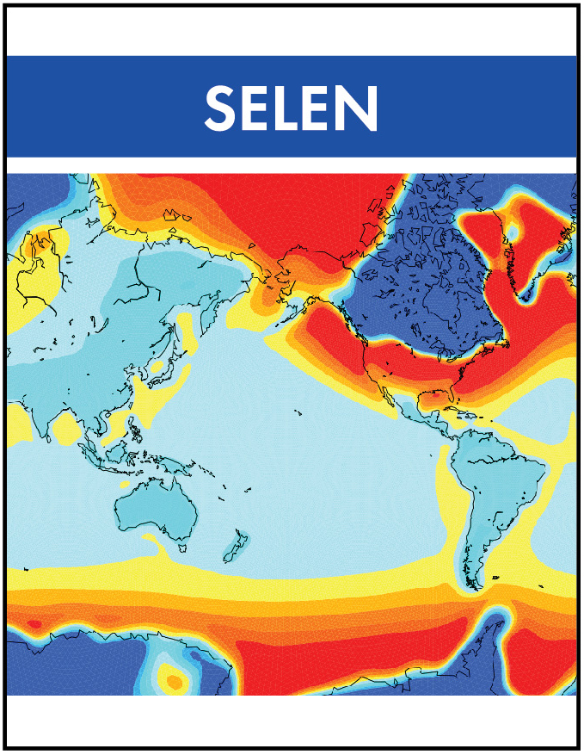
Software Development
Successful CIG codes mix community
and CIG development and support
Entirely
CIG
funded
Community Contributed
Building and sustaining teams
software engineering, domain expertise, & community building
deal.ii
ASH
PETSc
Notes:
Software becomes part of our community in a variety of ways and runs the spectrum between ……
We build and sustain communities that combine software engineering and domain expertise.
Relies on existing packages and includes domain expertise from developers of these packages.
ASPECT – deail.ii, trilinos – 2D – 3D thermal convection
Rayleigh – ASH from the solar community – understanding magnetohydrodynamics – solar & planetary dynamos
PyLith – PETSc a core component of PyLith – understanding short term crustal deformation on the time scale of the earthquake cycle
SELEN – glacial isostatic adjustment OR sea level equation solver

Slide 3
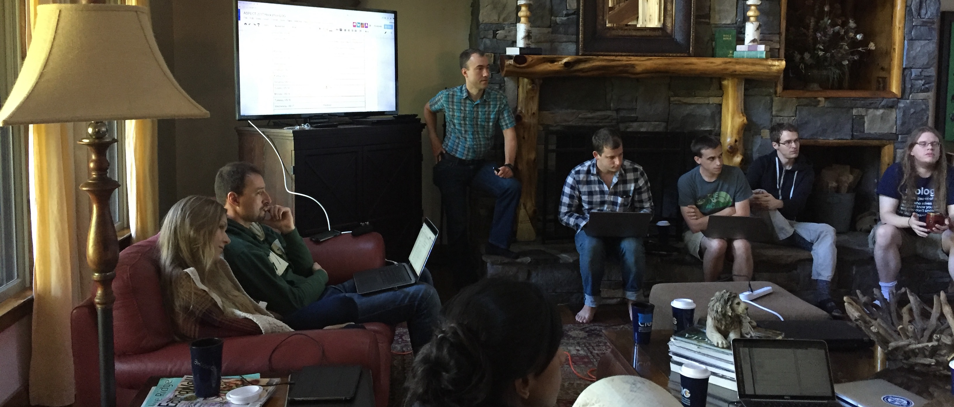
developers
Challenge: Sustaining Communities
researchers
sustaining communities sustaining innovation
Notes:
This is a socio-technical challenge

Slide 4
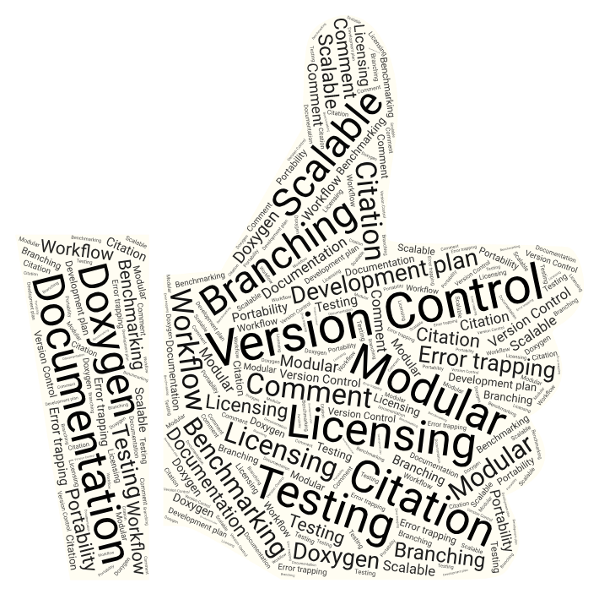
Supporting software technical
CHALLENGE
new tools
variety workflows
appropriate for research?
tiered best practices
Notes:
On the technical side it is about supporting software which include best practices in software development and software engineering.
Challenge is not only in implementing these but in keeping up with new tools and recommendations and sorting out which ones are appropriate for research.

Slide 5
Supporting Researcher-Developers social
faculty
???
industry
leave field
government
national lab
ngo
CHALLENGE
creating career paths for researchers who support software - RSE
graduate student
Notes:
creating career paths supporting job stability and growth

Slide 6




Supporting Researcher-Developers social
groups
small vs. large
international
hackathons
Notes:
https://www.shareicon.net/category/people?p=259
Icon made by Freepik from www.flaticon.com and www.shareicon.net
Photo by rawpixel on Unsplash

Slide 7
Hack + thons = sprint + scrum + mini-tutorials
71 committers
646 commits
“Committer 0”
1st hack !
Notes:
Projects take on the characteristics of project leadership
Just because a project is open source this is different than open and welcoming.
Part of a hack is in creating the community and instilling an open, inclusive, and collegial culture.

Slide 8
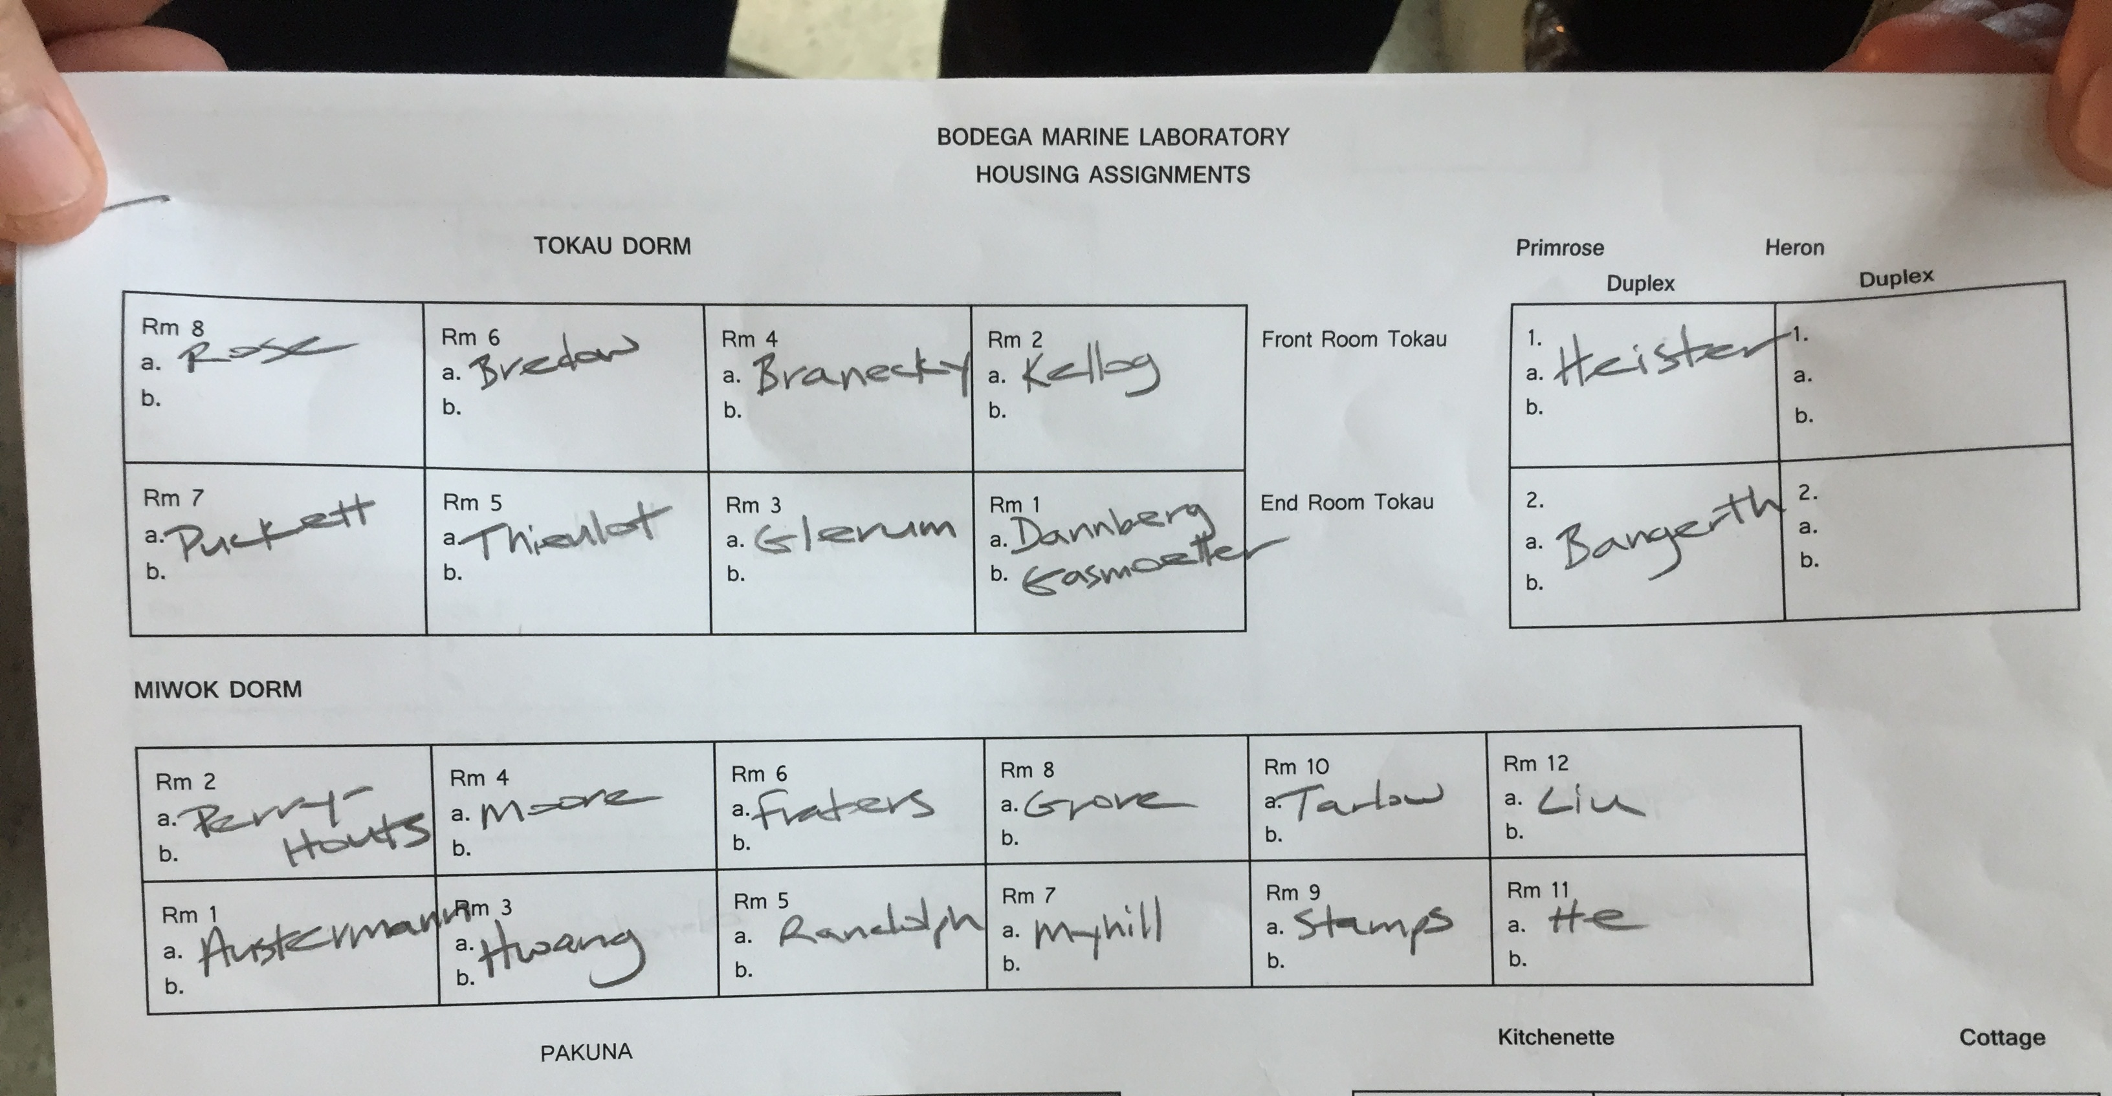
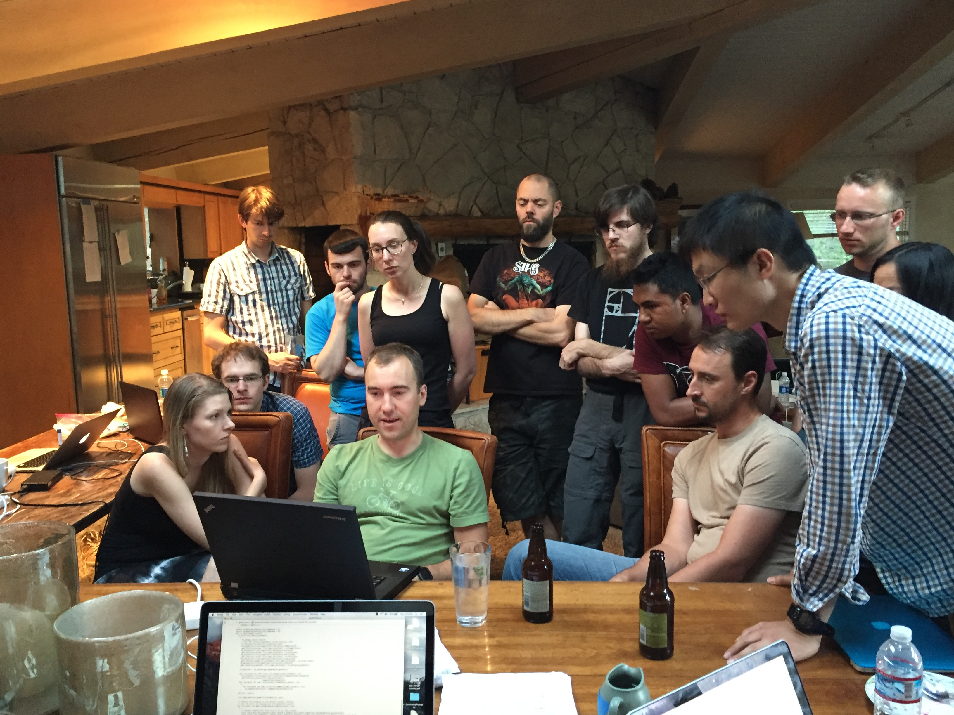
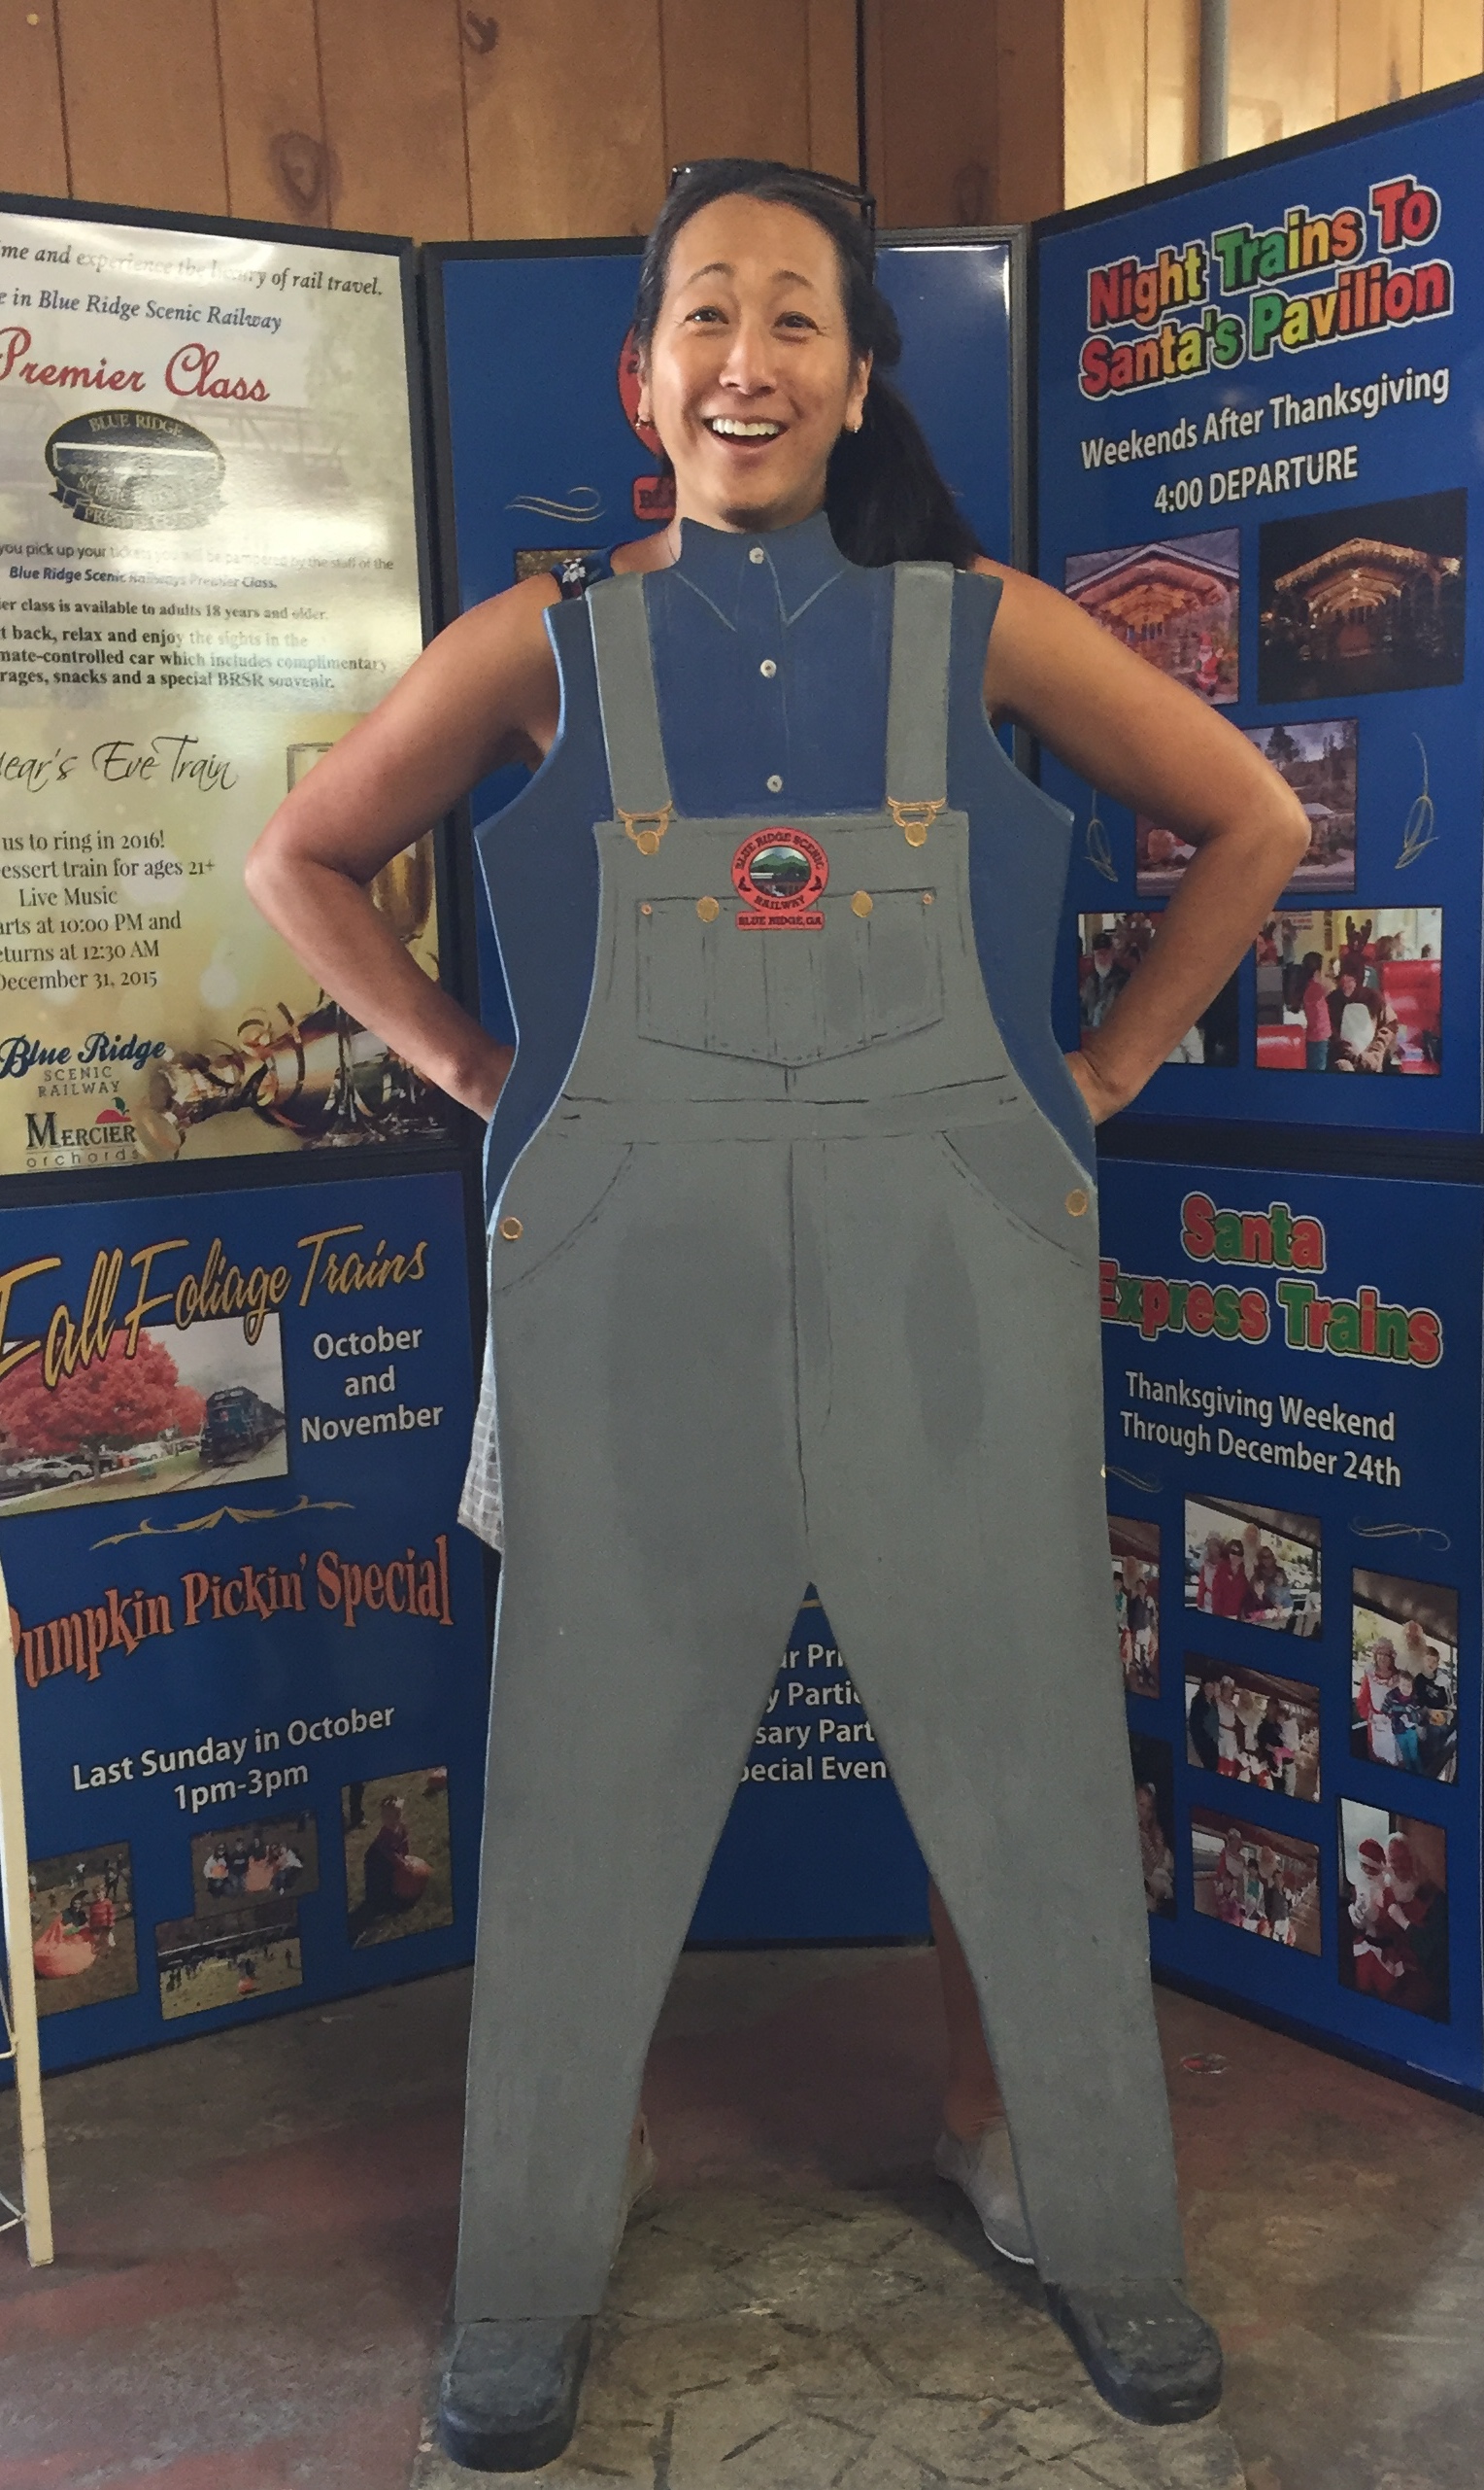
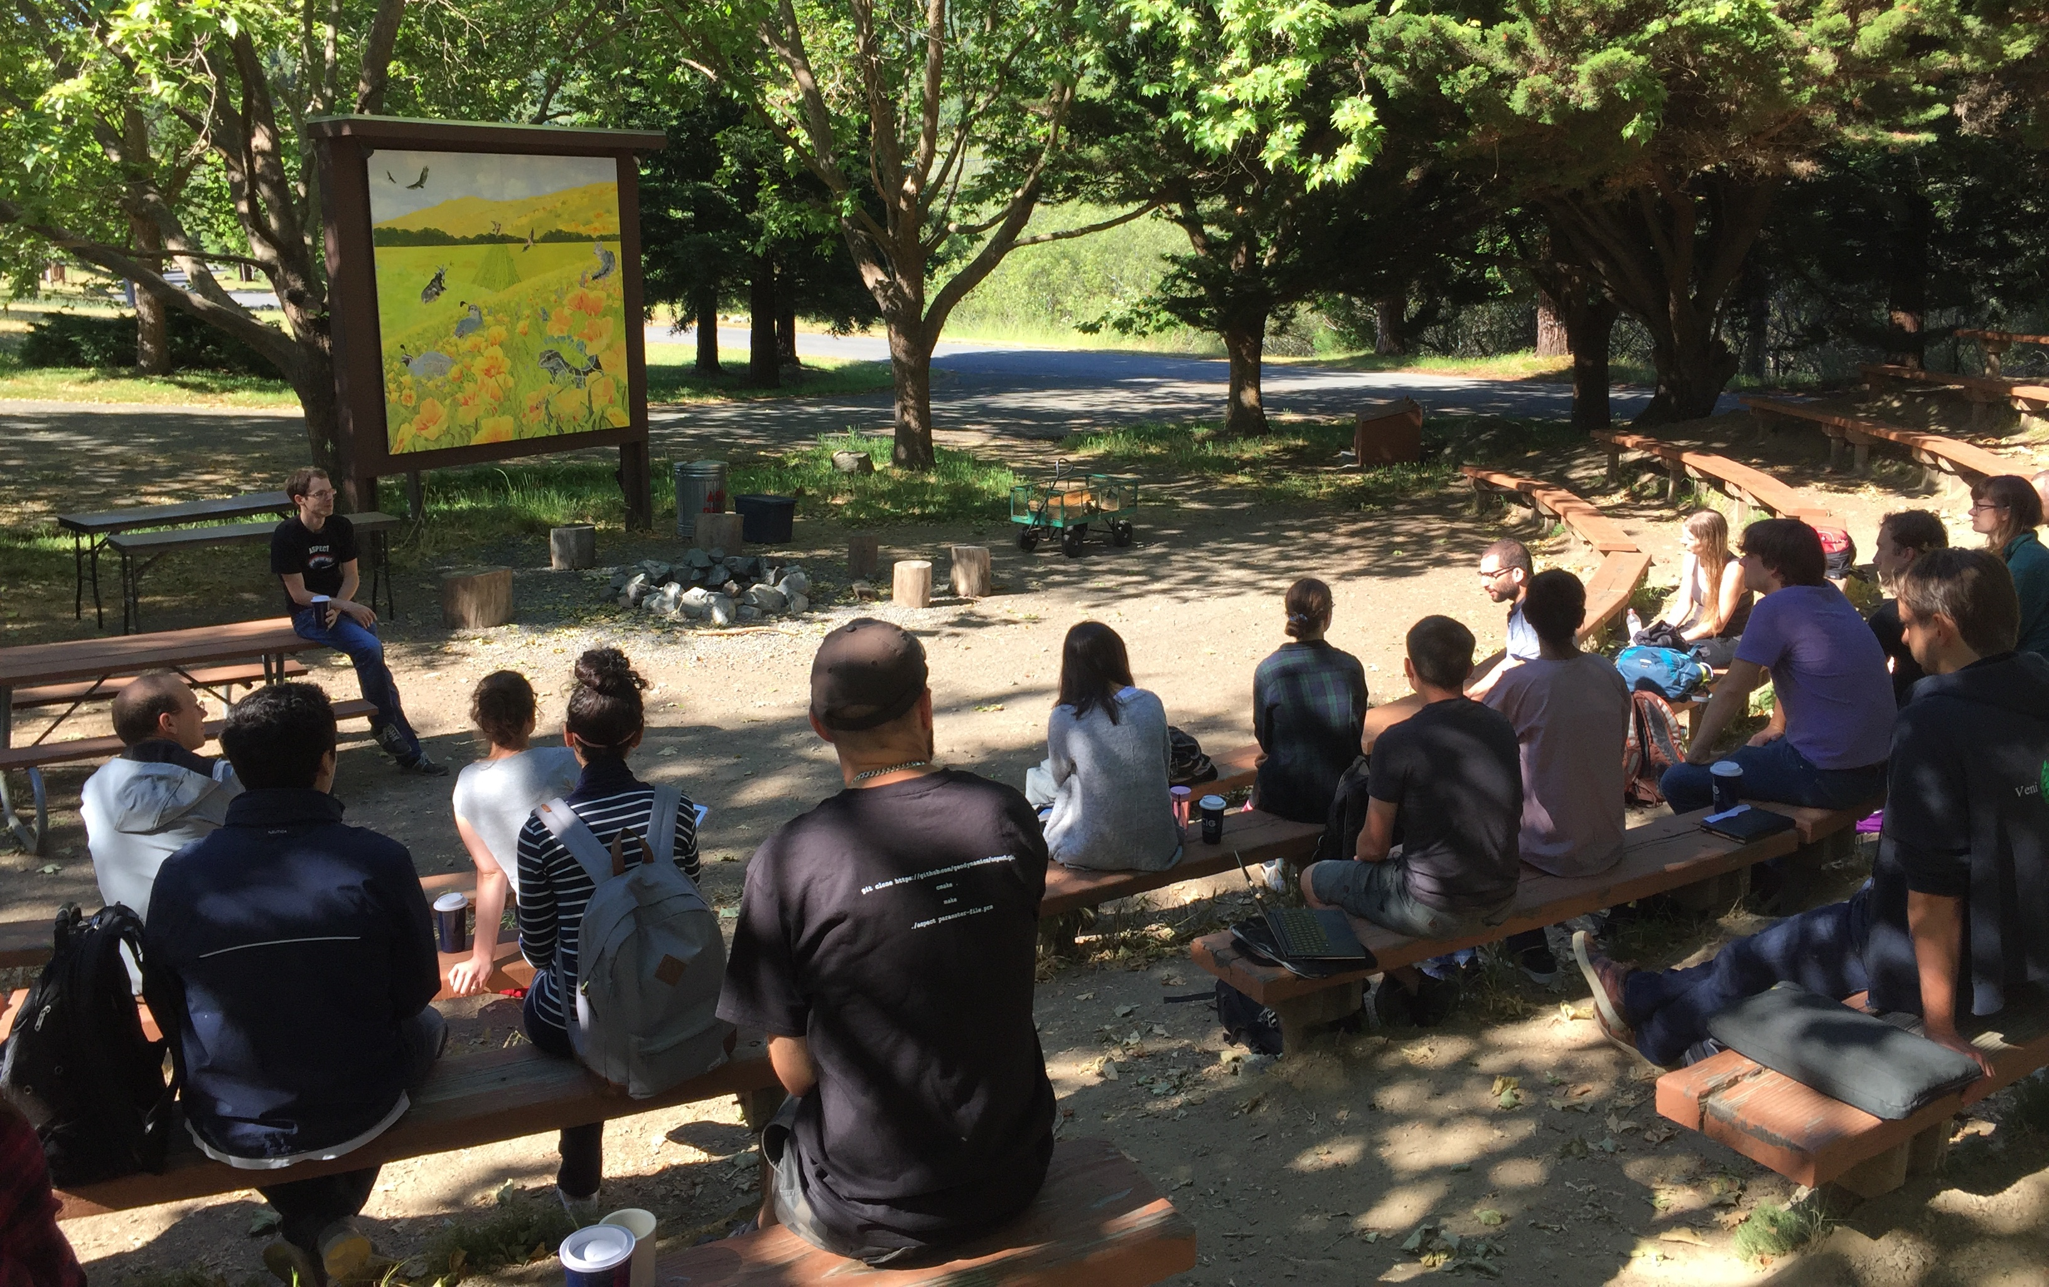
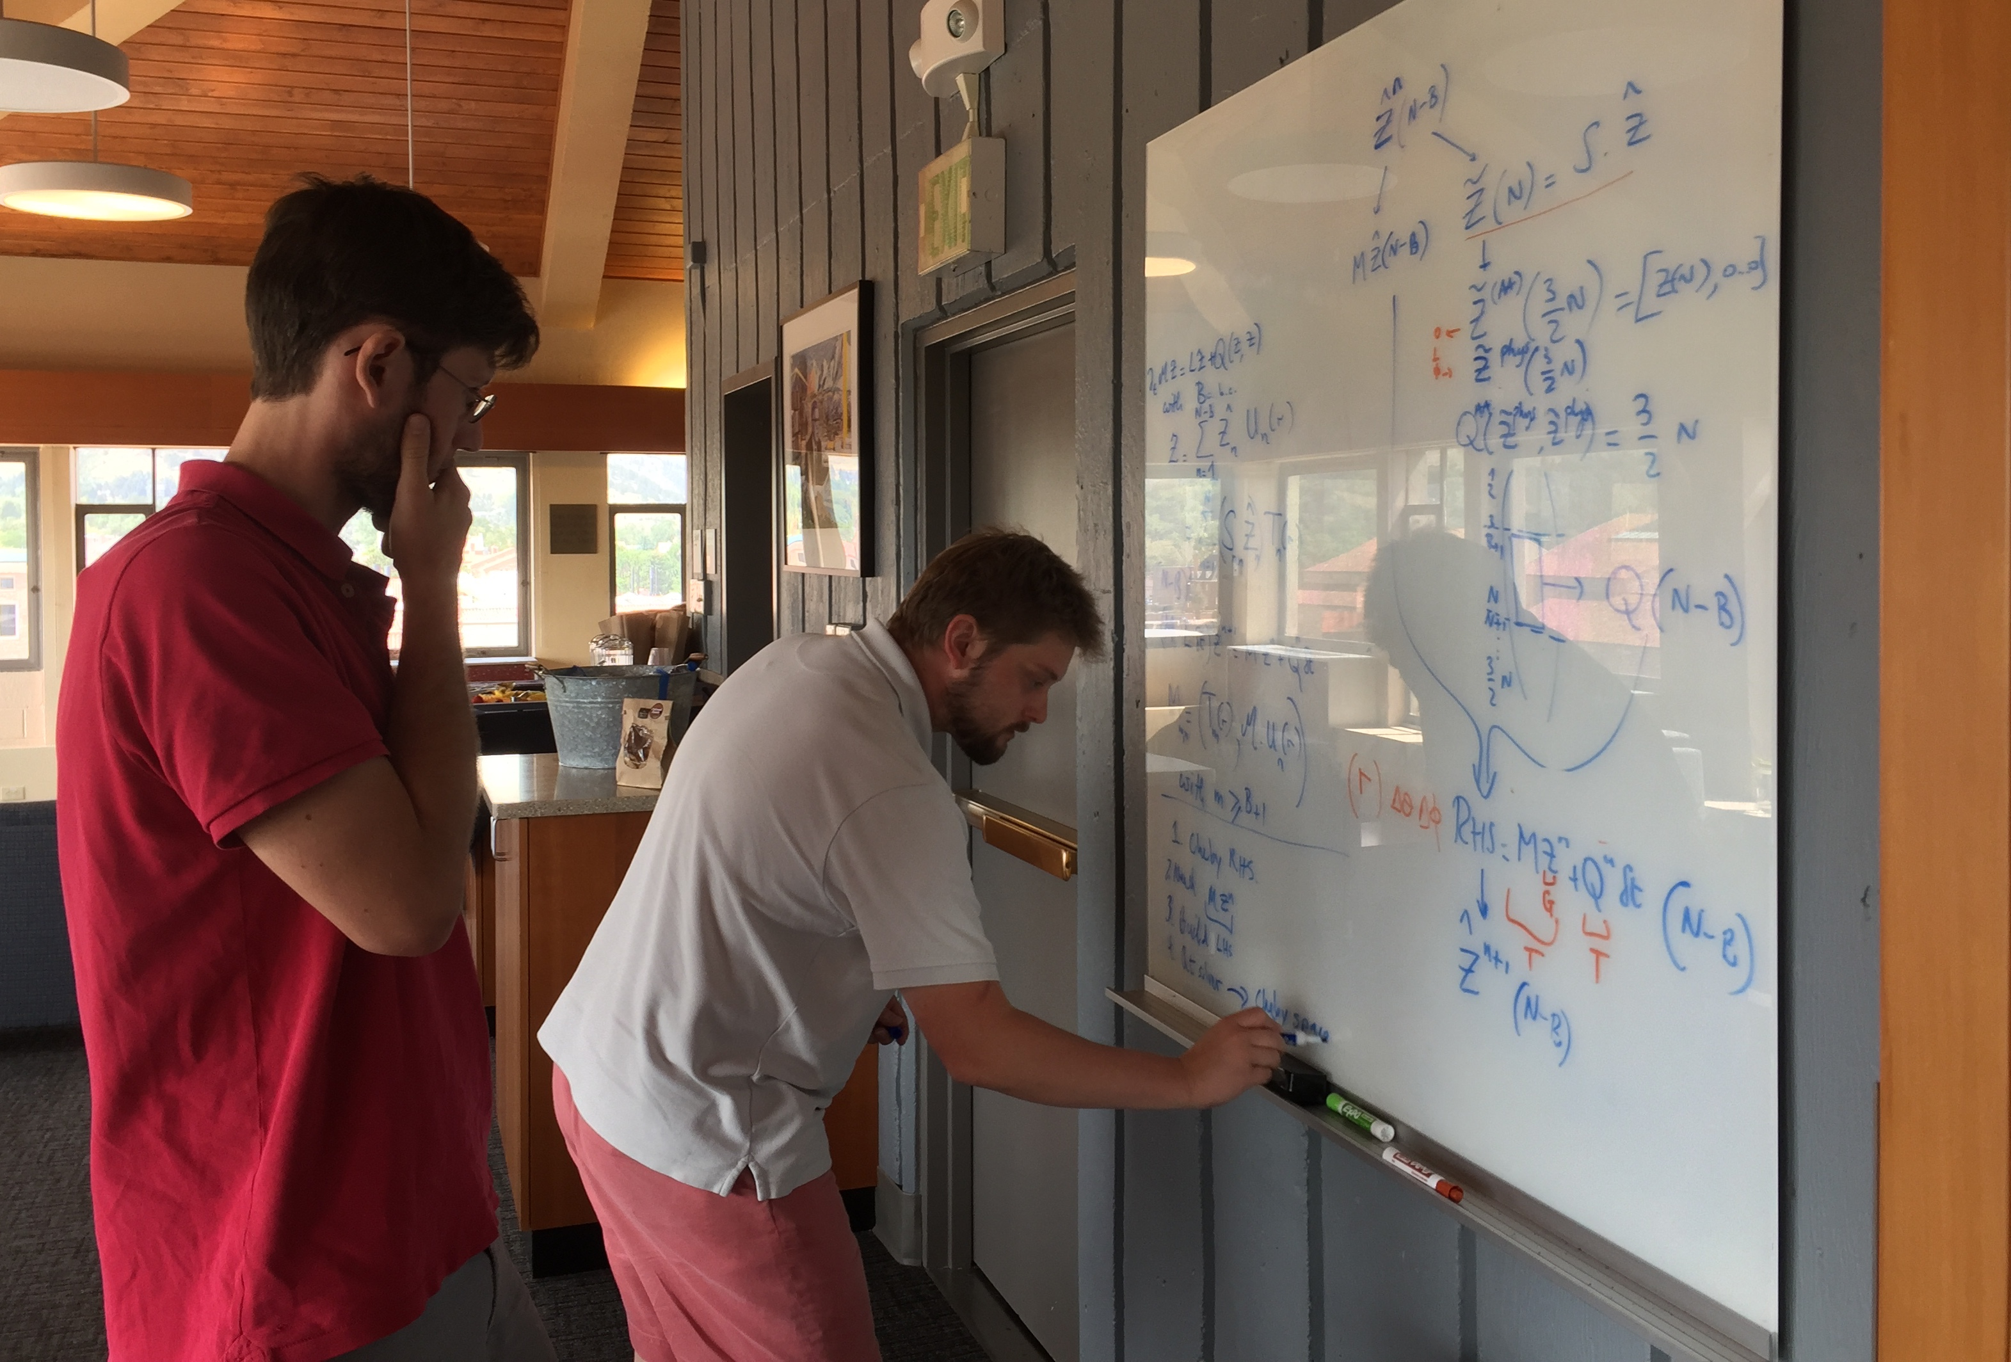
To sustain software and its developers community, we must address the both the social and technical challenges in creating an open culture.
Notes:
Open = both open source and open and welcoming communities.

